Slide 1

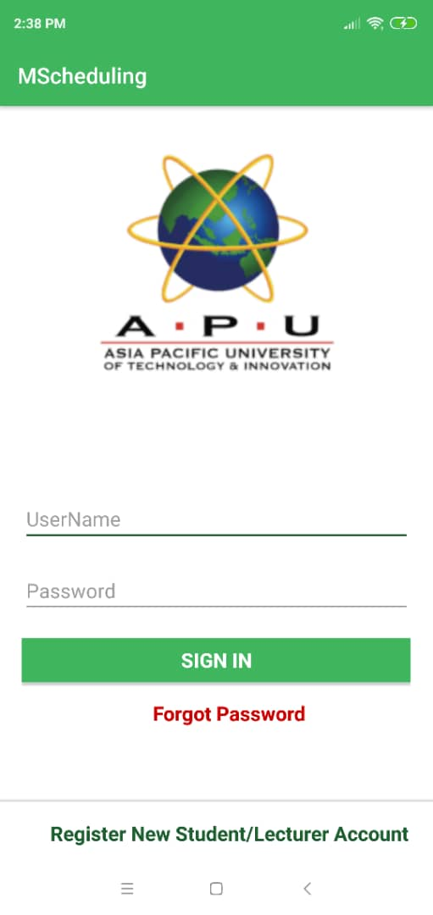
Centralized Scheduling System for Lab Booking and Lecturer’s
Consultation Hour Md. Easir Arafat B.Sc. Software Engineering– UC3F1805SE
Introduction
Users
Conclusion
The main purpose of this project is to develop an android application for centralized scheduling system to provide convenience in scheduling lecture time-table, available computer lab booking, lecturer’s consultation hour booking. This application would be helping students in an easier way to book the consolation hour with the lecturers. Moreover, it will also help lecturers to reduce time to set their available consultation hour and available IT lab booking.
Students
Lecturers
Admin
The previous system was a web application and the lecturers had to go through many links and pages just to see their timetable. The admin office also had to suffer by helping lecturers manage the labs for consultation.
“MScheduling” allows the students to chat directly with the lecturers. Students can view the lecturer details. They can also choose or cancel the consultations as per preferences. So, now they do not have to go to the lecturer office for seeing him or chasing him. It will save time for the lecturers, students as well as admin office.
MScheduling
Objectives
To find out the problems which are faced by the lecturers and the students while booking an IT lab or consultation hour and provide best solution based on the problem.
To develop an android app for centralized scheduling system which would be he helping for lecturer’s consultation hour booking and IT lab reservation
To develop user-friendly interface in centralized scheduling system that everyone can use it without having any issues.
To create live chat system between lecturers and students for improving the communication
To make an option for student for giving rating and feedback about the consultation hour which will improve the study system in a better way
References
A. Allison , L., 2016. Inter-App Communication between Android Apps. ACM International Conferance, pp. 17-18.
Abrahamsson, P. et al., 2004. Mobile-D: An Agile Approach for Mobile Application. ACM DIGITAL LIBRARY, pp. 174-175.
Ambler, S. W., 2014. Agile Modeling. [Online] Available at: http://agilemodeling.com/essays/agileDesign.htm [Accessed 4 September 2018].
Anon., n.d. Android Developers. [Online] Available at: https://developer.android.com/training/basics/firstapp/creating-project].

